Slide 1
Horoscopes
And Pop culture

Slide 2
overview
Description
Zodiac signs/Horoscope diagram
Where in pop culture do we find horoscopes
Difference between everyday horoscopes and astrology horoscopes
{$data[pooja][pednekar]}

Slide 3
What are Horoscopes
An astrological forecast of a person's future.
a diagram of the positions of the planets and signs of the zodiac at a particular time and place.
{$data[pooja][pednekar]}
{$data[pooja][address]}
{$data[pooja][phone]}

Slide 4
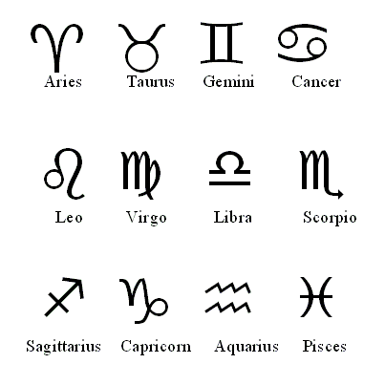
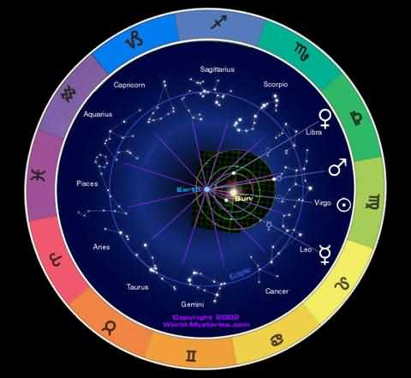
Horoscope Diagram and signs

Slide 5
Horoscopes in pop culture
Magazines
Newspaper
Internet
Celebrities
T.V. shows and movies
Notes:
Give examples for each…

Slide 6
Everyday Horoscopes Vs. Astrology Horoscopes

Slide 7
Everyday horoscopes
Everyday
Found in news papers and magazines
Very broad
Sometimes just made up

Slide 8
Astrology Horoscopes
Astrology
A reading of the planets and stars under which you were born.
Usually very specific

